Slide 1
US Fatal Police Shootings
Data Analysis
Xufan Wang, Yifei Song, Zhirui Li

Slide 2
Data Resources
The main dataset we choose is the Police Shootings in the US from https://www.washingtonpost.com/graphics/investigations/police-shootings-database/.
This database contains records of every fatal shooting in the United States by a police officer in the line of duty since Jan. 1, 2015. It is updated regularly as fatal shootings are reported and as facts emerge about individual cases.
Note that this does not include civilians killed in police custody, fatal shootings by off-duty officers, and non-shooting deaths.
The data was gathered via law enforcement websites, local news reports, and social media.
The data set includes data such as: name, date, manner of death, whether the person was armed, the age, gender, and race of the person, the city and state where the shooting took place, whether the person showed signs of mental illness, the threat level of the incident, whether the person was fleeing, and whether the officer in question had a body camera.

Slide 3
Research Question
What variables have the most effect to the case number of fatal police shooting
Build a model to predict whether fatal police shooting victims’ race is Black

Slide 4
Exploratory Data Analysis

Slide 5
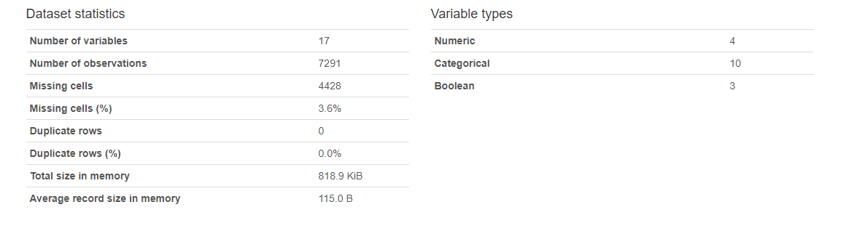
Overview

Slide 6
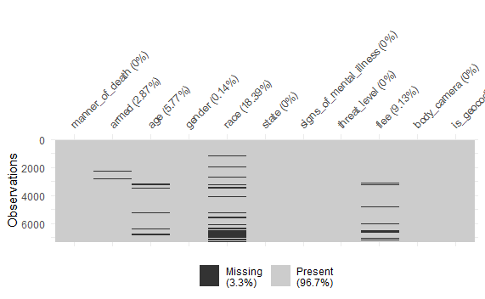
Missing Value

Slide 7
Data Visualizations

Slide 8
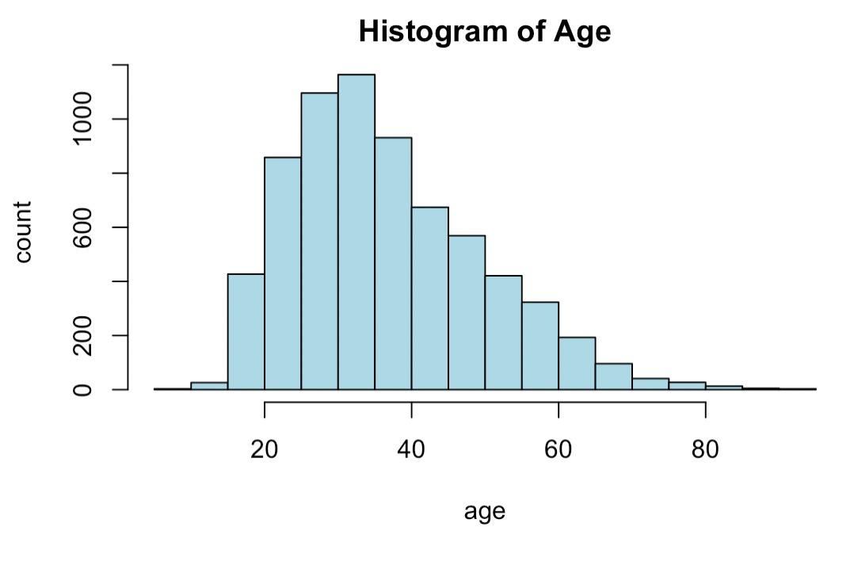
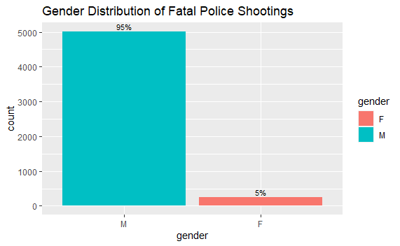
Age and Gender Distribution

Slide 9
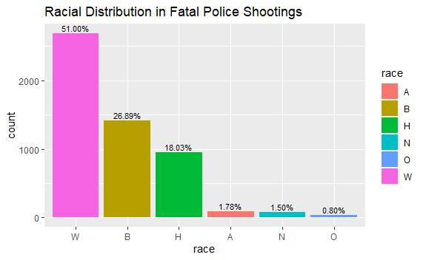
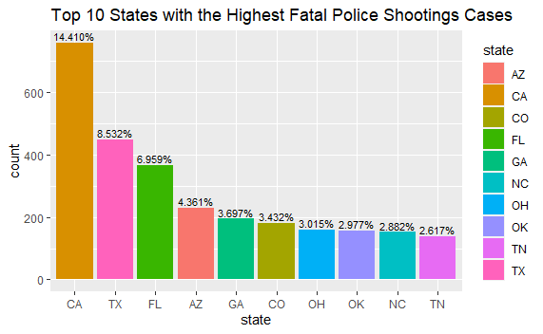
Racial Distribution and States with Top 10 Cases

Slide 10
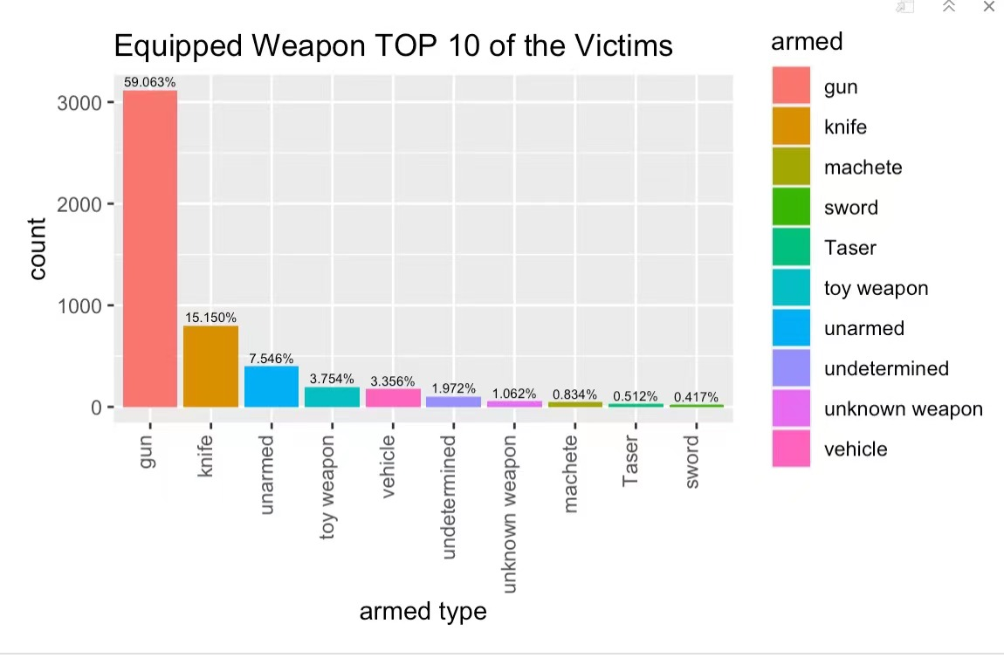
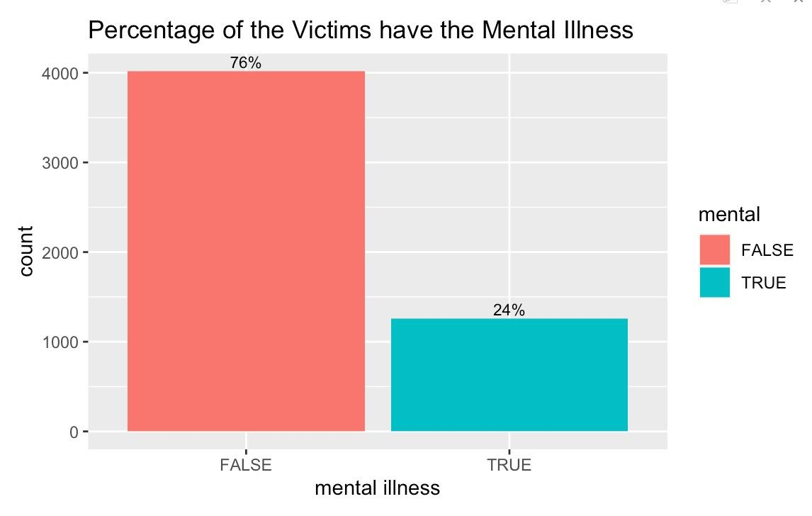
Top 10 Armed Type and Mental Illness

Slide 11
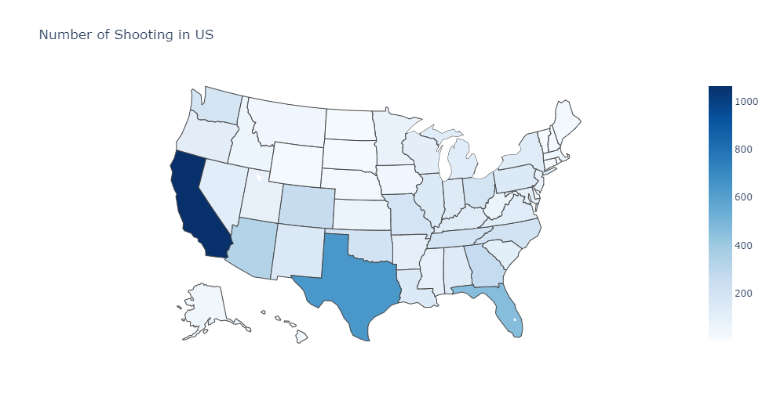
Geographic graph of shooting cases in US

Slide 12
Further Research
with Additional Data

Slide 13
Data Source
There are altogether three additional datasets. These are US census data on poverty rate, high school graduation rate, median household income. These dataset can be found from the following link:
https://www.kaggle.com/datasets/kwullum/fatal-police-shootings-in-the-us?select=MedianHouseholdIncome2015.csv

Slide 14
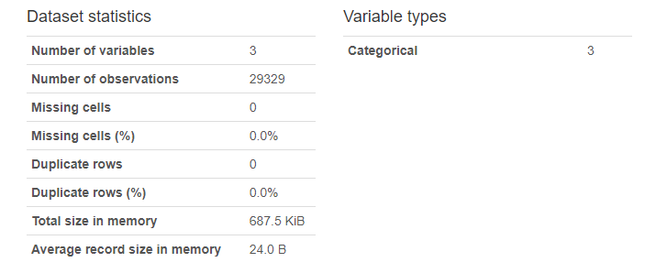
Overview

Slide 15
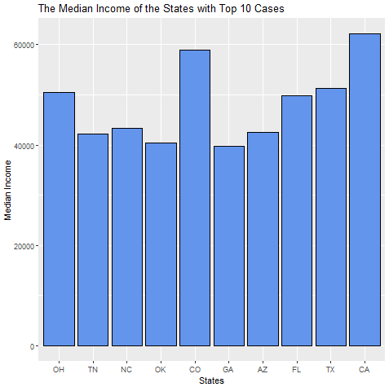
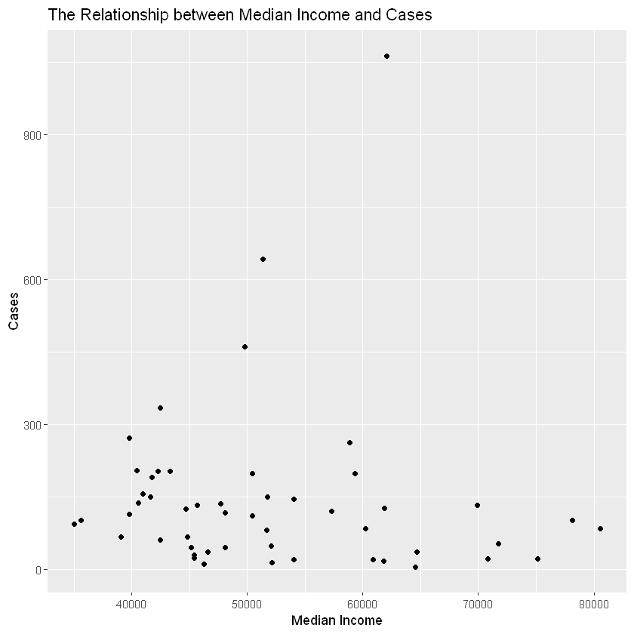
Median Income

Slide 16
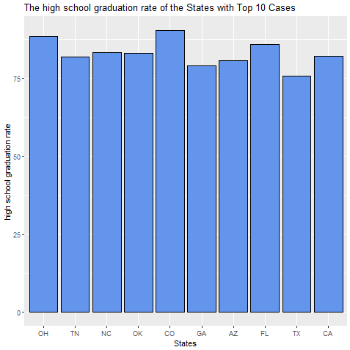
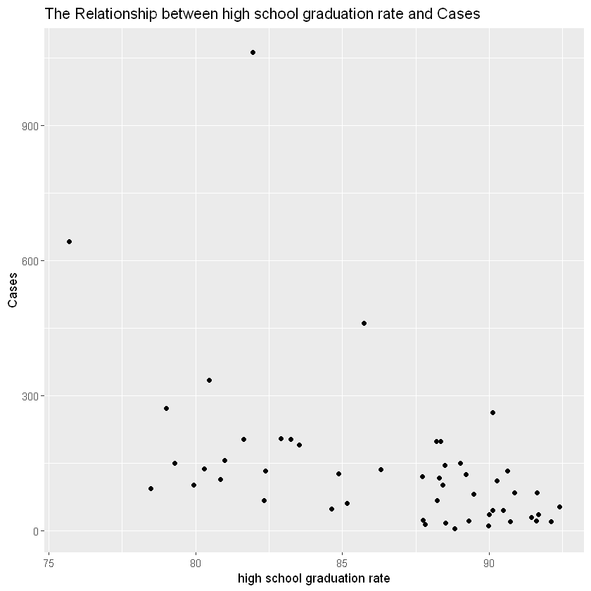
High School Graduation Rate

Slide 17
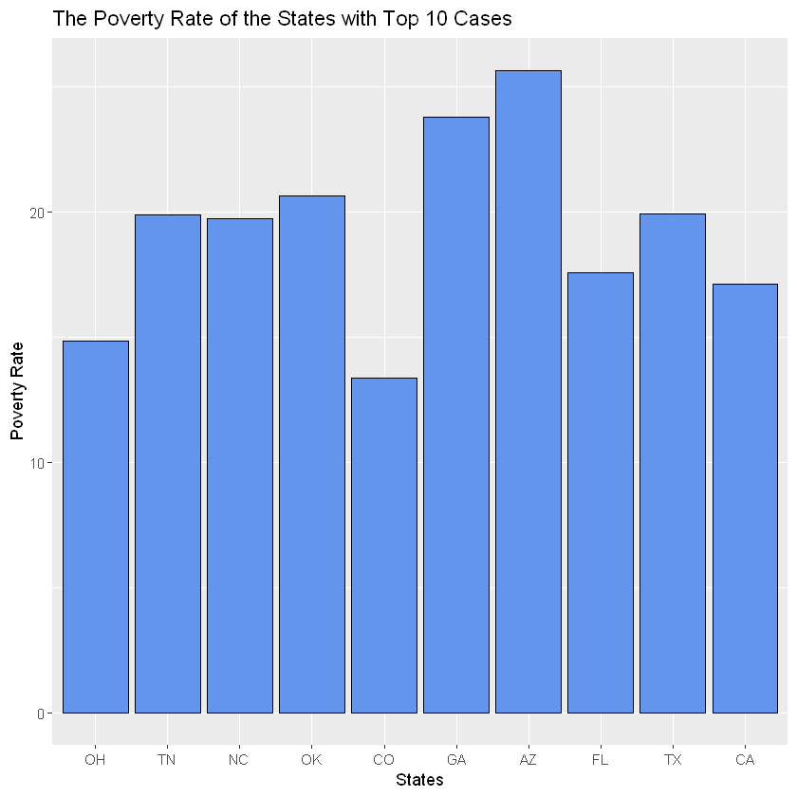
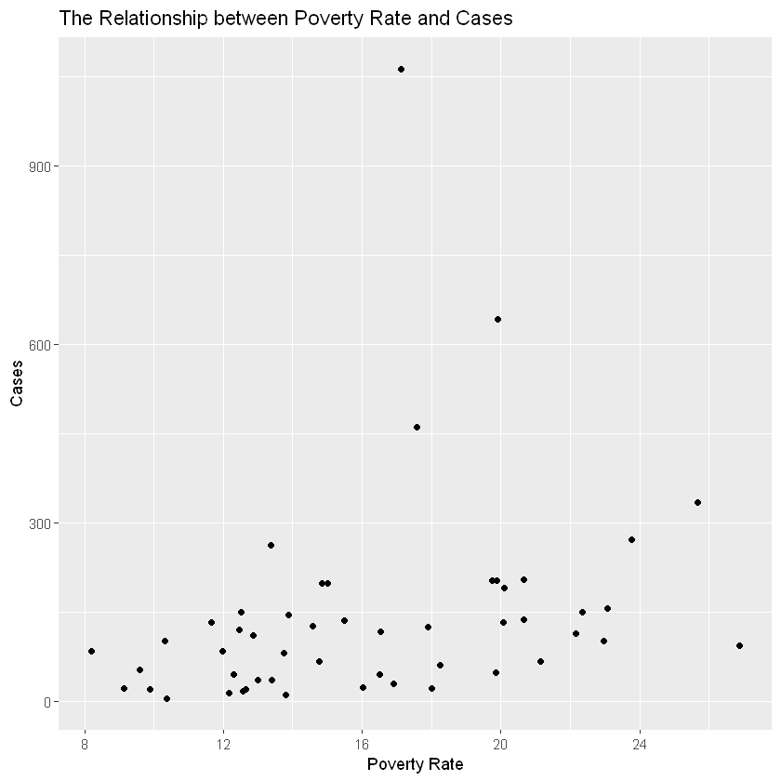
Poverty Rate

Slide 18
Logistic Regression

Slide 19
Logistic Regression Model
If race is black, encoded as 1. Otherwise, encoded as 0.
Convert all categorical variables to factors.
Standardize all continuous variables to prevent multicollinearity and help the model to converge faster.
Split the whole dataset into training(80%) and testing(20%).
Mixed effects logistic regression model and logistic regression model chosen by forward stepwise regression without random effects.

Slide 20
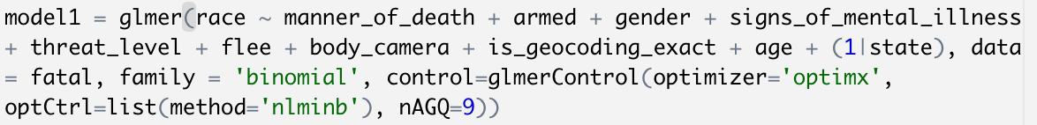
Mixed Effects Logistic Regression

Slide 21
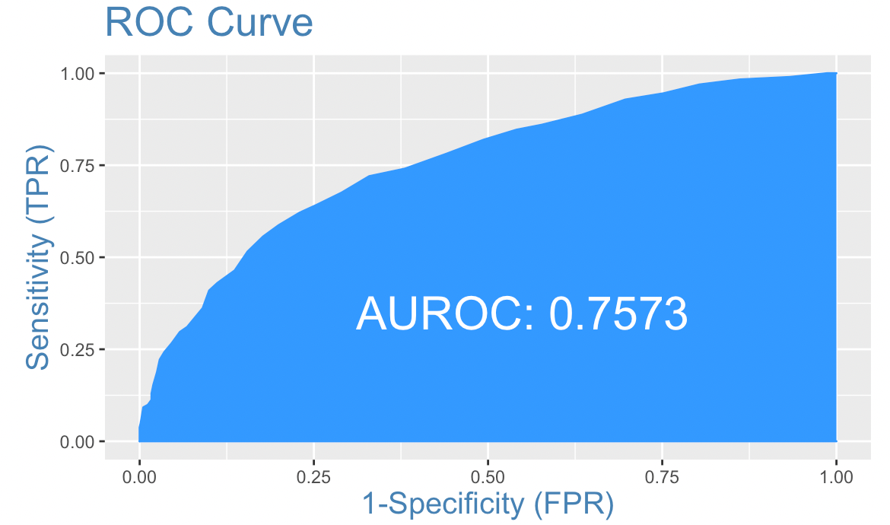
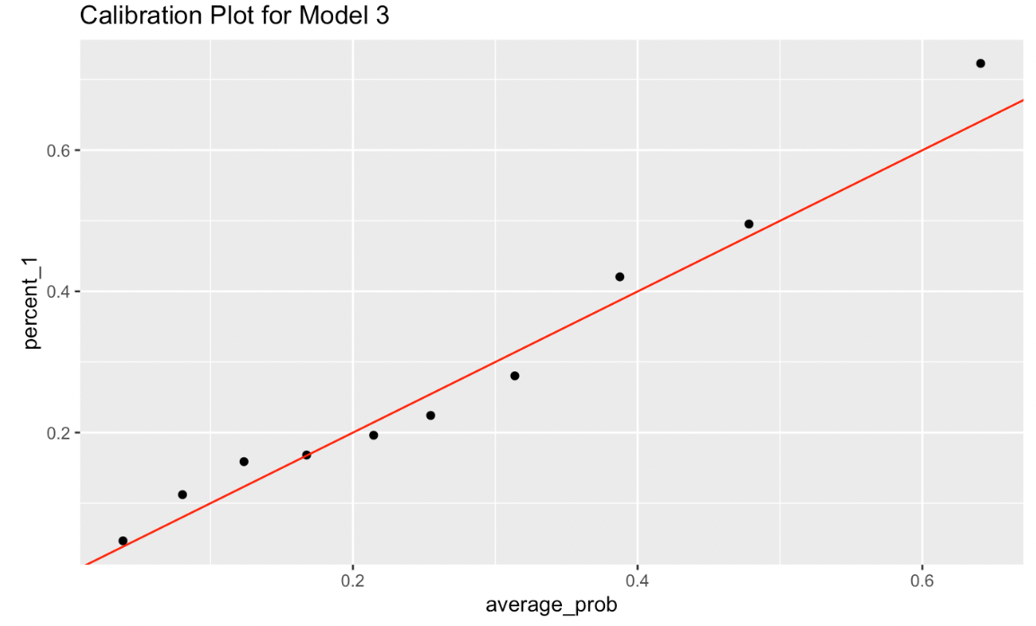
Mixed Effects Logistic Regression
* Graphs are based on test set.

Slide 22
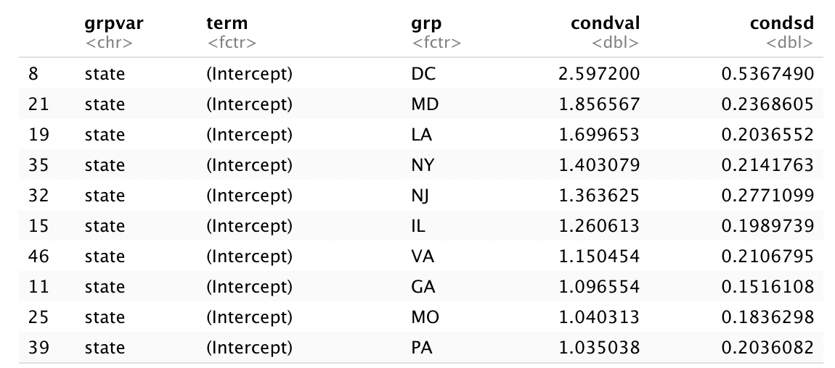
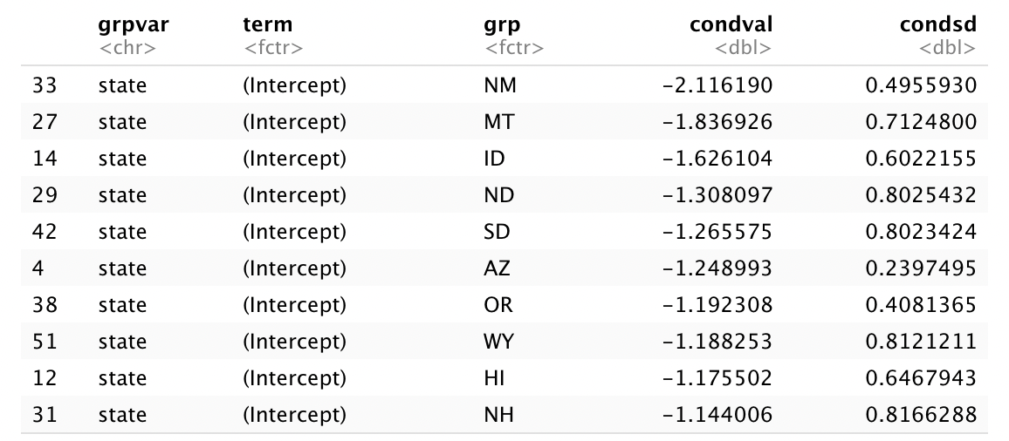
Mixed Effects Logistic Regression
Top 10 States:
Bottom 10 States:

Slide 23
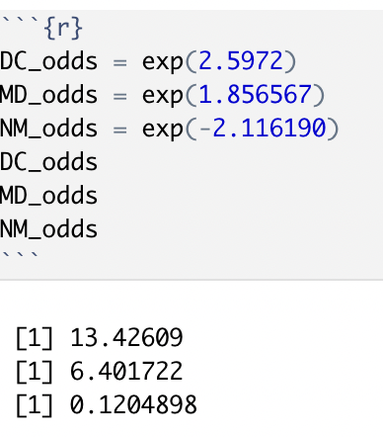
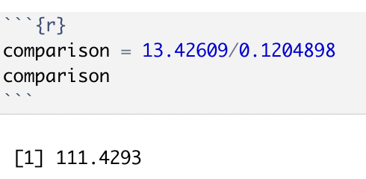
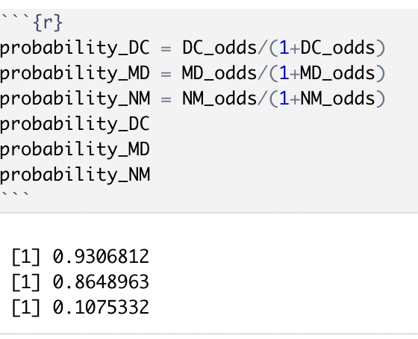
Mixed Effects Logistic Regression

Slide 24
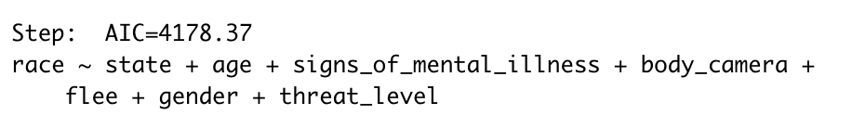
Forward Stepwise Selection without Random Effects

Slide 25
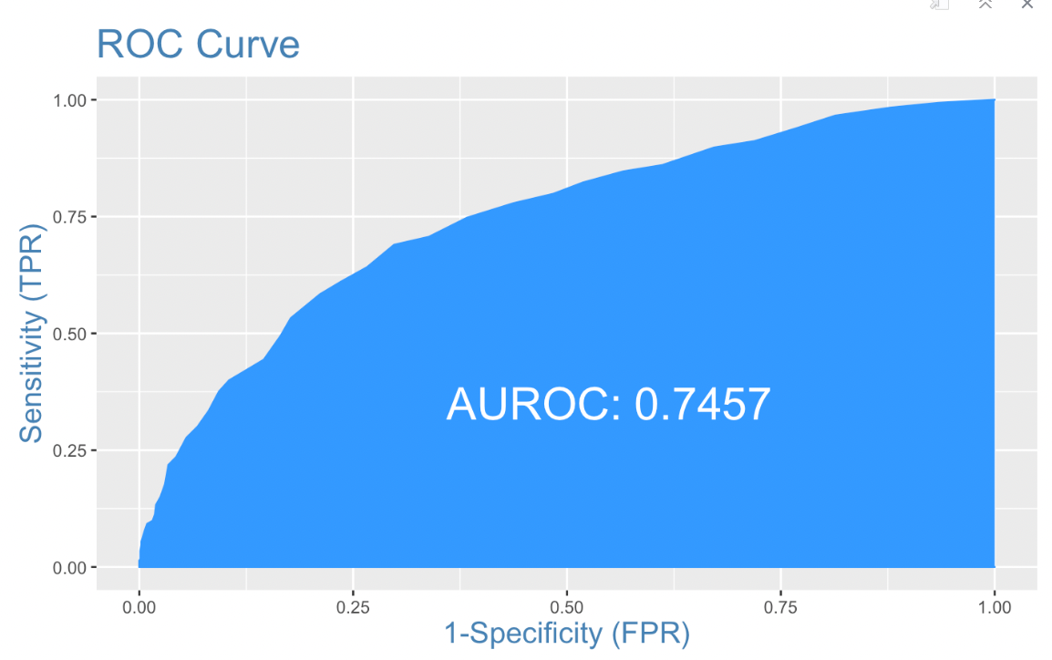
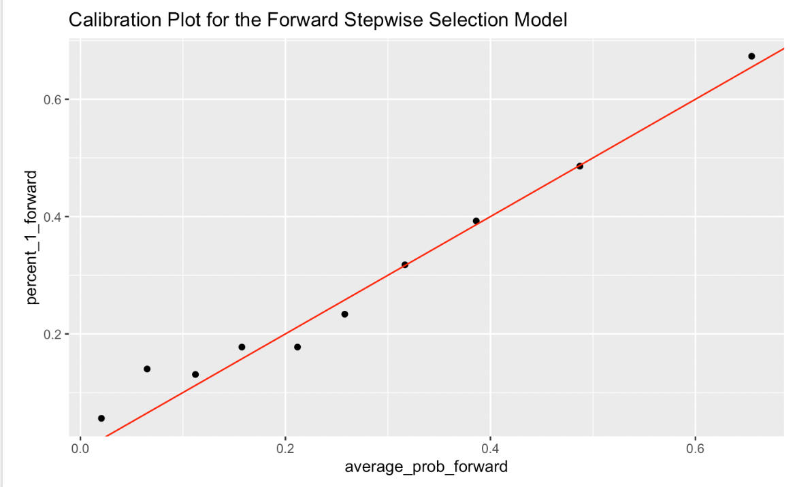
Forward Stepwise Selection without Random Effects
* Graphs are based on test set.

Slide 26
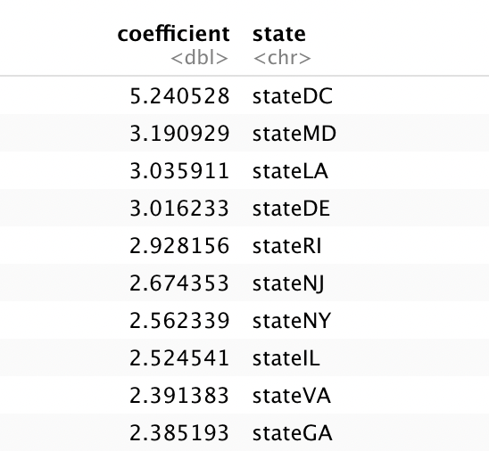
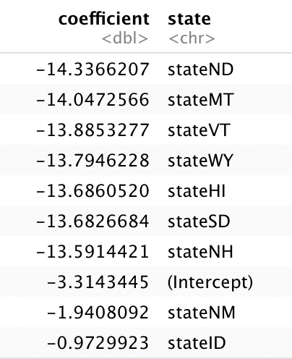
Forward Stepwise Selection without Random Effects
Top 10 States:
Bottom 10 States:

Slide 27
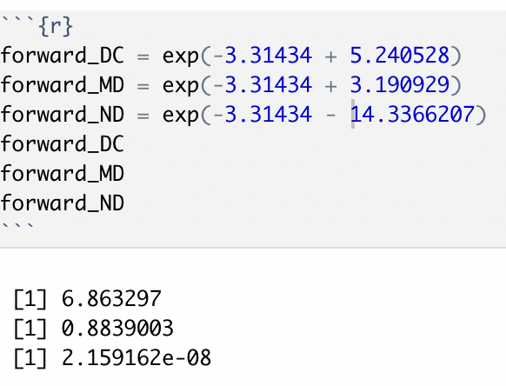
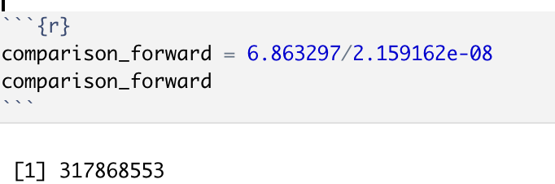
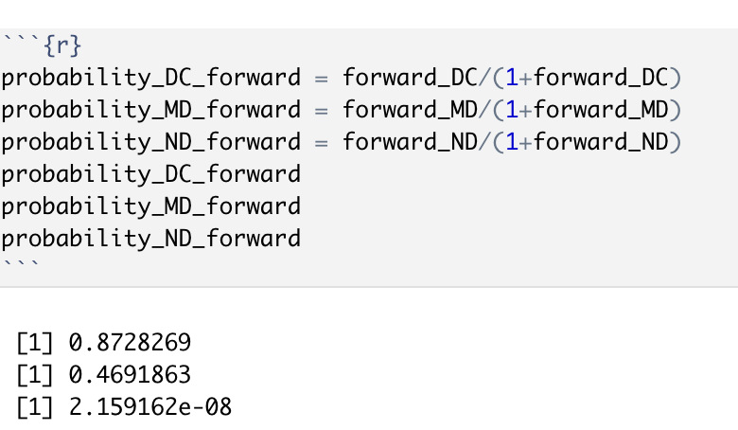
Forward Stepwise Selection without Random Effects

Slide 28
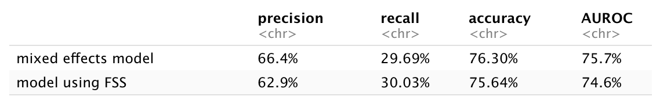
Model Comparison on Test Set

Slide 29
Contributions
Xufan Wang, Yifei Song: EDA and Analysis
Zhirui Li: Logistic Regression Model

Slide 30
Thank you for watching!

